Slide 1
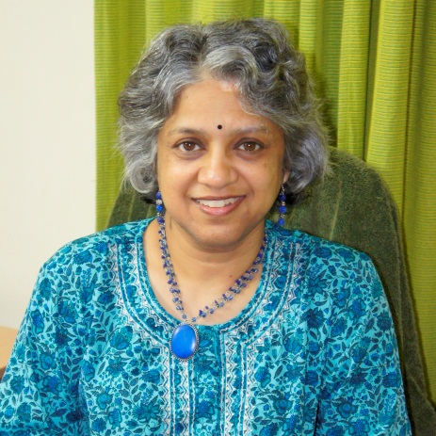
What do Master level students in computer science think about plagiarism?
Anders Berglund
Uppsala Computing Education Research Group,
Council for Educational Development at the Faculty of Science and Technology,
Uppsala University, Sweden
Neena Thota
University of Saint Joseph, Macau.
Uppsala Computing Education Research Group
Uppsala University, Sweden.

Slide 2
What do Master level students in computer science think about plagiarism?
Our master programme in computer science
What we do to prevent plagiarism?
The students thinking about plagiarism
What is plagiarism, according to the students?
”Would you help a friend?”
Understanding plagiarism

Slide 3
Our master programme in Computer Science, Uppsala University
Two year master programme in Computer Science
Intake 20 – 80 students per year (2012: approx 50)
Taught in English
World-wide recruitment
Some from Sweden
Most from Asia
”Largest” individual country: China

Slide 4
Plagiarism is a problem – how we try to tackle it
Data from survey forms the core of this presentation
Teaching about plagiarism
academic honesty
underlying values and objectives
writing academic texts
Discussing plagiarism
A survey serves as a point of departure for discussions with students
Students practising writing

Slide 5
Everyone is against cheating Everyone is against plagiarism
From our teaching, international master level students in computer science:
But what does ”cheating” actually mean?
And what is ”plagiarism”?

Slide 6
From our teaching, international master level students in computer science: What is fair and what is not?
We demand that you work in teams
vs.
We demand that you do not ”hide” in a group
We encourage you to help each other
vs.
We say that your results must be your own
We refer to material from Internet and tell you to do your own background research
vs.
We demand that you do an original work
Hard for
everyone

Slide 7
From our teaching, international master level students in computer science: What is fair and what is not?
Everyone is against cheating
Everyone is against plagiarism
…but …
The thinking on what plagiarism means varies from culture to culture.
The thinking is culturally situated.

Slide 8
The survey on plagiarism
The survey:
Compulsory part of the course – almost 100% answer rate
Open questions
2007 - 2011
219 students
Most important questions (abbreviated):
What is plagiarism, according to you?
A scenario: If your friend is in trouble (too low results, giving problems with Swedish visa etc.), would you help him/her? Why? Why not?

Slide 9
“What is plagiarism?” Different ways of understanding plagiarism (phenomenographic analysis)
Definition of plagiarism
“Plagiarism is to copy all of the material from others”
Prevents learning
“For me it doesn't make sense. I study because I really enjoy learning stuff”
Personal issue
“Plagiarism may limit your creativity and make you depend on others. I will get nothing at the end.”
Community issue
“ … unfair …”
Ethical issue
“Plagiarism is such a shame. It is unprofessional and unethical”
Cultural issue
“… the definition is different between different people and cultures”
Low complexity Hitgh complexity
Categories ”grow” during the analysis
Based on quotes from all studens
Each category depicts a certain way of understandning (”seeing”) plagiarism
An individual can express several ways of understanding plagiarism
The categories are ordered, according to the complexity of the understanding.

Slide 10
Master 2011 Scenario 1
Your are working in the computer lab with a complicated lab that should be done individually and that should be ready the following day. You are doing well. Another students asks for your help. He/she says:
"Could you help me with this lab? If I fail, the Swedish Migration Board might say that my results are too poor, and I risk not get a visa for the next year. I will help you next time".
What do you answer?

Slide 11
”Would you help a friend?” The scenario
Predetermined categories
Our categorisations of the students’ answers

Slide 12
”Would you help a friend?” Why do students state that they help or do not help their friends?
Reasons to help
Own learning
Expect reciprocal help
Social intent, creating a learning community
Helps a friend to learn
Empathy for a friend
Reasons not to help
Fear of consequence
Not their responsibility
Personal ethical values
University regulations
Helps a friend to learn
Directed towards
self
Directed towards others
Notes:
Original:
Reasons to help
Helps a friend to learn
Self learning
Future help
Empathy
Social intent
Reasons not to help
Assignment requirement
Responsibility
Ethical issue
Fear of consequence
Helps a friend to learn

Slide 13
Understanding plagiarism is complicated
One picture:
Blame the student!
Students are lazy
Students are stupid
Students are dishonest
Students are under stress
The assignments are too difficult
➔
More controls
Harder punishment
There is evidence
that this is not the
full picture

Slide 14
Understanding plagiarism is complicated
Alternative picture: Understand the student!
Students understand plagiarism in different ways
Students say they would act in different ways in complex situations.
Attitudes to plagiarism varies over
individuals,
cultures,
contexts and
specific situation
There are tensions between
how students understand plagiarism vs.
how students say they would act
There are tensions between
me/self vs.
my friends/the collective/others

